Slide 1
Convolutional Neural Networks (CNNs)
Generated for: Introduction to CNNs, Convolution Operation, Pooling Layers, CNN Architecture Example, Applications of CNNs
Notes:
Welcome to the Convolutional Neural Networks (CNNs) presentation covering multiple topics. Today we'll explore: Introduction to CNNs, Convolution Operation, Pooling Layers, CNN Architecture Example, Applications of CNNs.

Slide 2
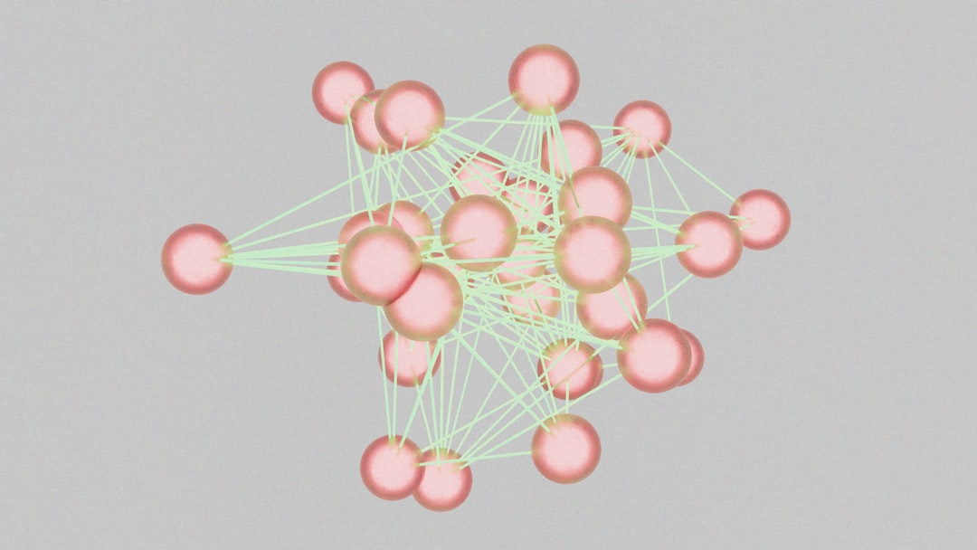
Introduction to CNNs - Introduction
Convolutional Neural Networks (CNNs) are deep learning models
Inspired by biological neural networks and visual cortex
Used for image and video processing applications
Effective in pattern recognition and feature extraction
Consist of convolutional and pooling layers
Fully connected layers for classification tasks
Activation functions like ReLU and Sigmoid used
Backpropagation for training and optimization
CNNs have many real-world applications and variants
Notes:
When introducing CNNs, explain the biological inspiration behind these models and their effectiveness in image and video processing. Provide examples of real-world applications such as self-driving cars, facial recognition, and medical imaging. Ask students about their prior knowledge of neural networks and what they expect to learn from this topic. Key takeaways include understanding the basic architecture of CNNs and their role in deep learning.

Slide 3
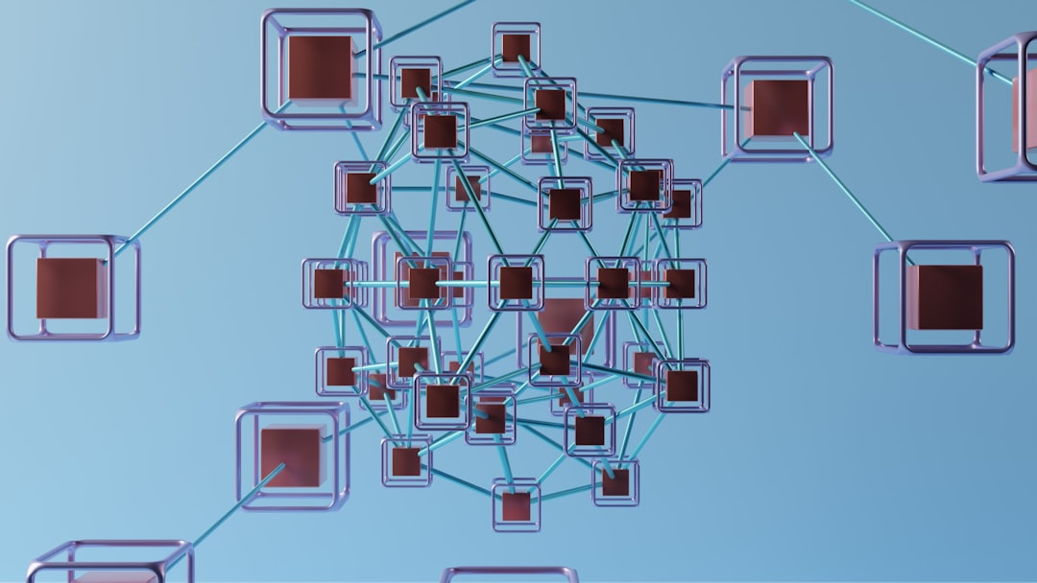
Introduction to CNNs - Introduction
Convolutional Neural Networks (CNNs) are deep learning models
Inspired by biological neural networks and visual cortex
Used for image and video processing tasks
Can learn spatial hierarchies of features automatically
Consist of convolutional and pooling layers
Followed by fully connected layers for classification
Can be trained on large datasets for accuracy
Applied in self-driving cars and facial recognition
Require significant computational resources and data
Y = σ(WX + b) simple neural network equation
Notes:
When introducing CNNs, start by explaining the biological inspiration behind these models, highlighting how they mimic the human visual cortex. Provide examples of applications such as image recognition, self-driving cars, and facial recognition to illustrate their practical uses. Discuss the basic architecture, including convolutional, pooling, and fully connected layers. Mention the need for large datasets and computational resources. Use the simple neural network equation Y = σ(WX + b) to introduce the concept of neural network computations. Ask students to consider what types of problems might be suited to CNNs and how they differ from other machine learning models. Key takeaways should include understanding the basic components of a CNN and their applications in real-world scenarios.

Slide 4
Introduction to CNNs - Architecture
CNNs consist of convolutional and pooling layers
Convolutional layers extract local features
Pooling layers reduce spatial dimensions
Fully connected layers enable classification
Activation functions introduce non-linearity
ReLU is a commonly used activation function
CNNs use backpropagation for training
Batch normalization improves training speed
Dropout prevents overfitting in CNNs
y = σ(Wx + b) is a simple neural network equation
Notes:
When explaining the architecture of CNNs, emphasize the role of convolutional and pooling layers in feature extraction and dimensionality reduction. Provide examples of how these layers are used in image classification tasks, such as handwritten digit recognition. Ask students to consider the importance of activation functions and how they introduce non-linearity into the model. Discuss the benefits of batch normalization and dropout in improving training speed and preventing overfitting. Key takeaways include understanding the basic components of a CNN and how they work together to enable image classification.

Slide 5
Convolution Operation - Introduction
Convolution operation combines image data with filters
Extracts local features from small image regions
Applies filters to entire image with stride
Stride defines filter movement over image
Convolution enables spatial hierarchy learning
Used in image processing and computer vision
Key component of Convolutional Neural Networks
Enables image feature extraction and classification
Preserves spatial relationships in data
Improves model performance with reduced parameters
Notes:
When introducing the convolution operation, explain how it works by combining image data with filters to extract local features. Provide examples of image processing and computer vision applications, such as edge detection and object recognition. Emphasize the importance of stride in defining filter movement and its impact on spatial hierarchy learning. Use visual aids to illustrate the convolution process and ask students to consider how this operation enables image feature extraction and classification. Key takeaways include understanding the role of convolution in CNNs and its ability to preserve spatial relationships in data, leading to improved model performance with reduced parameters.

